Slide 1
Air Masses and fronts
An air mass is a large body of air that has similar temperature and moisture properties throughout.
A front is defined as the transition zone between two air masses of different density.
Fronts extend not only in the horizontal direction, but in the vertical as well. Therefore, when referring to the frontal surface (or frontal zone), we referring to both the horizontal and vertical components of the front.

Slide 2
Prevailing winds.
Prevailing winds are the general patters of convection currents rising from the equator towards the poles and back again.
The actual course of our prevailing winds is described in the illustration on the right. The reason our winds follow such a pattern is related to several factors, including the rotation of the earth, variations in the earth’s surface and variations in the earth’s revolution

Slide 3
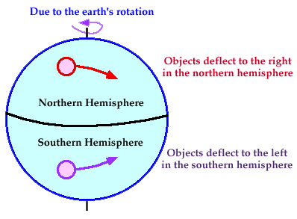
Coriolis Force
Once air has been set in motion by the pressure gradient force, it undergoes an apparent deflection from its path, as seen by an observer on the earth. This apparent deflection is called the "Coriolis force" and is a result of the earth's rotation.

Slide 4
As air moves from high to low pressure in the northern hemisphere, it is deflected to the right by the Coriolis force. In the southern hemisphere, air moving from high to low pressure is deflected to the left by the Coriolis force.
The amount of deflection the air makes is directly related to both the speed at which the air is moving and its latitude. Therefore, slowly blowing winds will be deflected only a small amount, while stronger winds will be deflected more. Likewise, winds blowing closer to the poles will be deflected more than winds at the same speed closer to the equator. The Coriolis force is zero right at the equator.

Slide 5
Sea Breezes a result of uneven surface heating
When spending a day at the beach, a noticeable drop in temperature may occur during the early afternoon as a cool breeze begins to blow off of the water. This wind is known as the "sea breeze", which occurs in response to differences in temperature between a body of water and neighboring land.

Slide 6
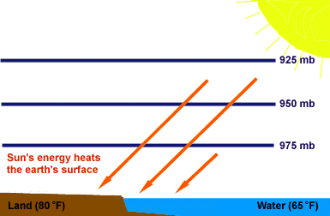
Sea-breeze circulations most often occur on warm sunny days during the spring and summer when the temperature of the land is normally higher than the temperature of the water.
During the early morning hours, the land and the water start out at roughly the same temperature. On a calm morning, a given pressure surface will be at the same height above both the land and water.

Slide 7
A few hours later, the sun's energy begins to warm the land more rapidly than the water.
By later in the day, the temperature of the land increases while the temperature of the water remains relatively constant.
This occurs because water, especially large bodies of water like a lake or ocean, are able to absorb more energy than land without warming.

Slide 8
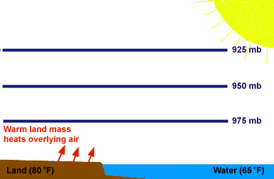
It is important to remember that the air is not heated directly from above by the sun. In fact, most of the incoming solar energy actually passes right through the atmosphere. However, as the land absorbs this energy, heat is radiated back into the atmosphere (from the earth), warming the overlying air. Some of this heat is transported to higher levels in the atmosphere through convection.
On the other hand, since the temperature of the water remains relatively constant throughout the day, the air over the water is not heated from below (as over land), resulting in lower air temperatures over the water.

Slide 9
Land Breezes begin with the cooling of low-level air
On clear, calm evenings, temperature differences between a body of water and neighboring land produce a cool wind that blows offshore. This wind is called a "land breeze". Land breezes are strongest along the immediate coastline but weaken considerably further inland.
Land-breeze circulations can occur at any time of year, but are most common during the fall and winter seasons when water temperatures are still fairly warm and nights are cool.

Slide 10
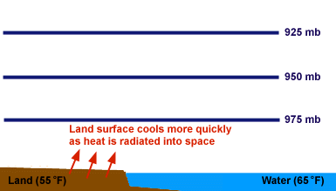
On clear and calm evenings, the earth's surface cools by radiating (giving off) heat back into space, and this results in a cooling of the immediately overlying air.

