Slide 1
Erosion Through Wave Action
Running water acts as an agent of erosion and deposition:
As we have seen, running water (usually illustrated through the life cycle of a river) can have a dramatic effect on a given landform.
There is a second way in which water acts as an agent of erosion, and that is through wave action.

Slide 2
Wave Erosion
Lakes and oceans derive their ability to erode from the wind.
When wind drags on the water’s surface, it transfers its energy through the water as friction. The result of this energy transfer is a wave.
These waves then strike coastal areas causing different erosion effects

Slide 3
Wave Erosion
The ways in which waves can change a coastline depend on how the coastline has been formed:
Some coastlines are a result of rising sea levels and some are a result of declining sea levels.
Sometimes glaciers recede and the land rebounds to form a coastline. In a similar process, sometimes sea levels fall, and a coastline emerges.

Slide 4
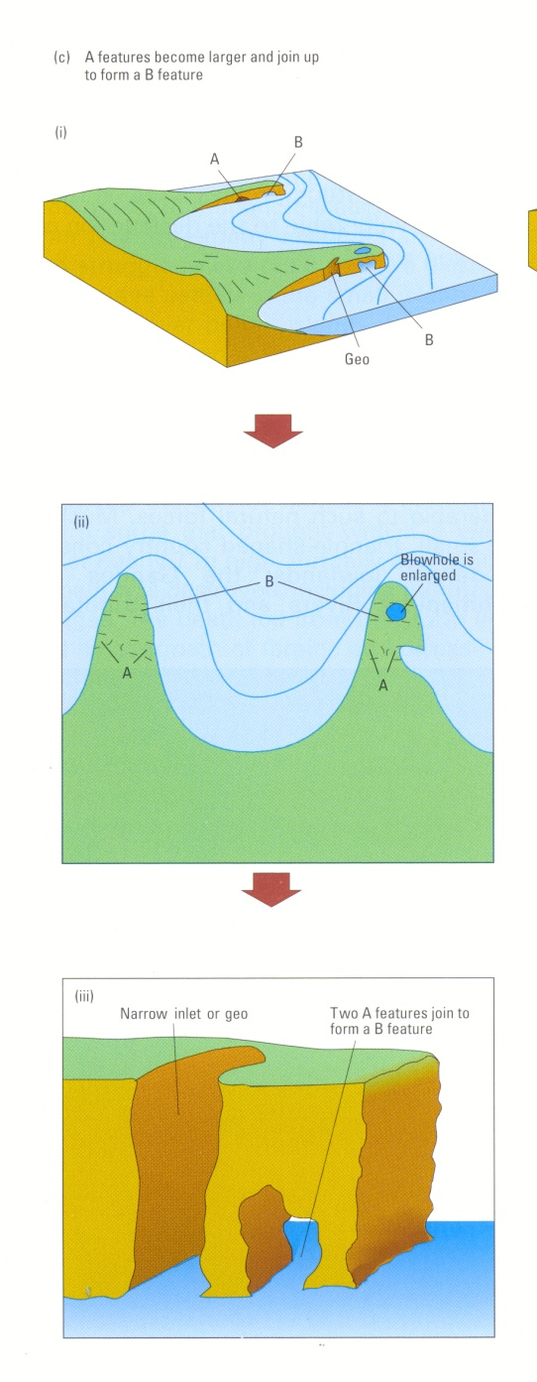
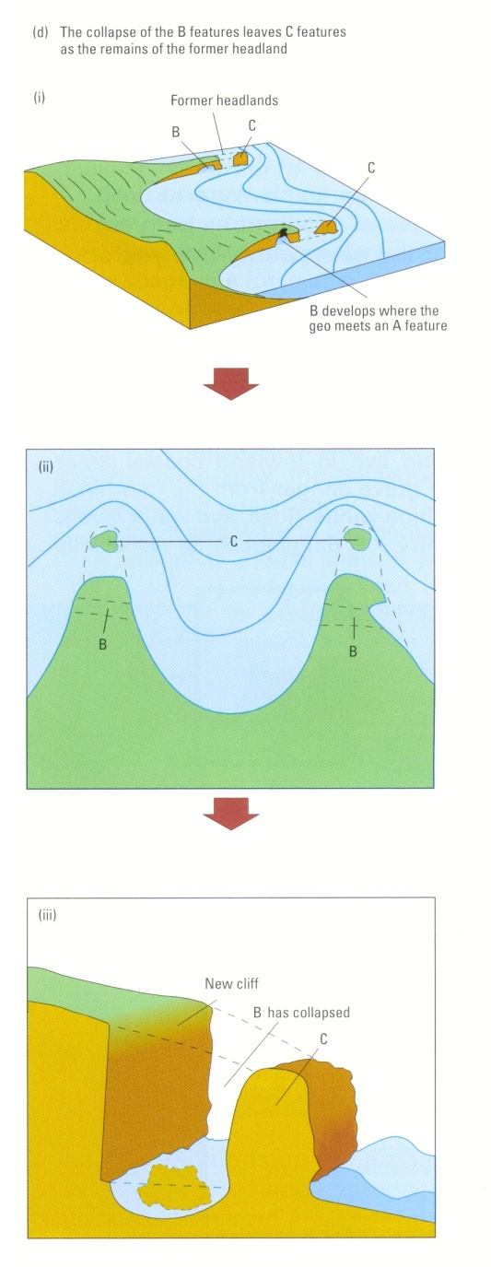
Emergent Coastline
Are the result of rising land levels (and falling sea/ice levels).

Slide 5
Submergent Coastline
This type of coastline results from rising sea levels and is illustrated in stages below:

