Slide 1
The life cycle of a river
The life cycle of a river helps explain how it acts as an agent of erosion.
It should be obvious that the force of running water will create erosion in the first place. Running water will physically move objects and “carve” or erode rock formations if the motion and volume of water is continual. In the “youth” stage of river cycle, a river does just this: It carves out a path to it’s final destination over rock formations, wearing away the land as it does so.

Slide 2
The two ways in which water acts as an agent of erosion
Rivers concentrate their energy to erode both vertically and laterally.
Vertical Erosion: A river erodes the bottom of its channel, and it is the chief from of erosion for a youthful river, usually formed at higher elevations.
Lateral Erosion: Gives older rivers their meandering shape, as a river flows faster along one bank, it erodes that bank. Conversely, as the water loses momentum on the opposite curve, it deposits sediment and loose materials on that bank, eventually filling it in.

Slide 3
Which Bank Reflects the erosion process at X Y ?

Slide 4
Youth
In it’s youthful stage, a river is characterized by:
A rapid flow
Steep valleys, waterfalls
Narrow, straight passages

Slide 5
The life cycle of a river
Gradually, the force of the youthful river will erode away most of the high ground around the river.
Subject to gravity, the water in the river will have to slow down, as a result of a gentler slope and a flat land surface.
At this point, a river comes to be known as mature

Slide 6
Characteristics of a mature river
Many well-developed Tributaries
Broad flat valley with a well developed flood plain

Slide 7
The life cycle of a river
A mature river represents roughly an equilibrium between erosion and deposition:
Its ability to erode material further and it’s ability to deposit material at the basin of the river are roughly equal
As the river ages further, the land around the river becomes extremely flat.
When this occurs, the river slows, loses momentum, and begins to deposit material more than it erodes.
At this point a river is said to be old

Slide 8
Characteristics of an old river
Very elaborate and meandering courses
Swampy areas
Oxbow Lakes

Slide 9
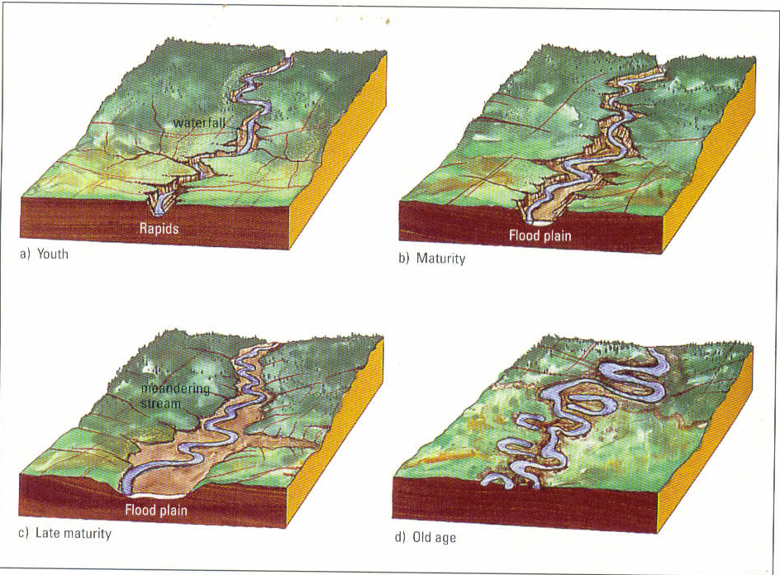
Diagram of the life cycle of rivers

Slide 10
Rivers as agents of Deposition
The material that a river erodes, is carried by the water to its end destination, be that a pond, lake, or the ocean.
This material is deposited in various locales by the running water as it loses its forward momentum, and the force of gravity causes the sediment to settle.
As a result we can say that rivers are also agents of deposition, creating various landforms.

