Slide 1
Pacific Ring of Fire
The "Ring of Fire" is an arc stretching from New Zealand, along the eastern edge of Asia, north across the Aleutian Islands of Alaska, and south along the coast of North and South America.
It is composed over 75% of the world's active and dormant volcanoes.
This huge ring of volcanic and seismic (earthquake) activity was noticed and described before the invention of the theory of plate tectonics theory.
We now know that the Ring of Fire is located at the borders of the Pacific Plate and other major tectonic plates.

Slide 2
Around the Ring of Fire, the Pacific Plate is colliding with and sliding underneath other plates.
This process is known as subduction and the volcanically and seismically active area nearby is known as a subduction zone.
There is a tremendous amount of energy created by these plates and they easily melt rock into magma, which rises to the surface as lava and forms volcanoes.

Slide 3
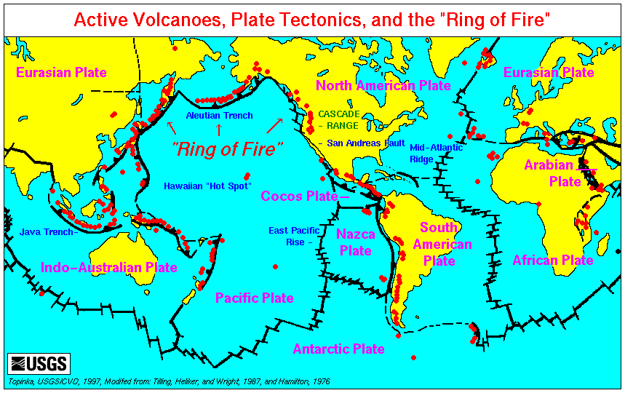

Slide 4
Fold Mountains
Fold mountains are mountains formed from the folding of the earth's crust.
Fold mountains are formed when two plates move together (a compressional plate margin).
This can be where two continental plates move towards each other or a continental and an oceanic plate.
The movement of the two plates forces sedimentary rocks upwards into a series of folds.
Fold mountains are usually formed from sedimentary rocks and are usually found along the edges continents. This is because the thickest deposits of sedimentary rock generally accumulate along the edges of continents.
When plates and the continents riding on them collide, the accumulated layers of rock crumple and fold like a tablecloth that is pushed across a table.

Slide 5
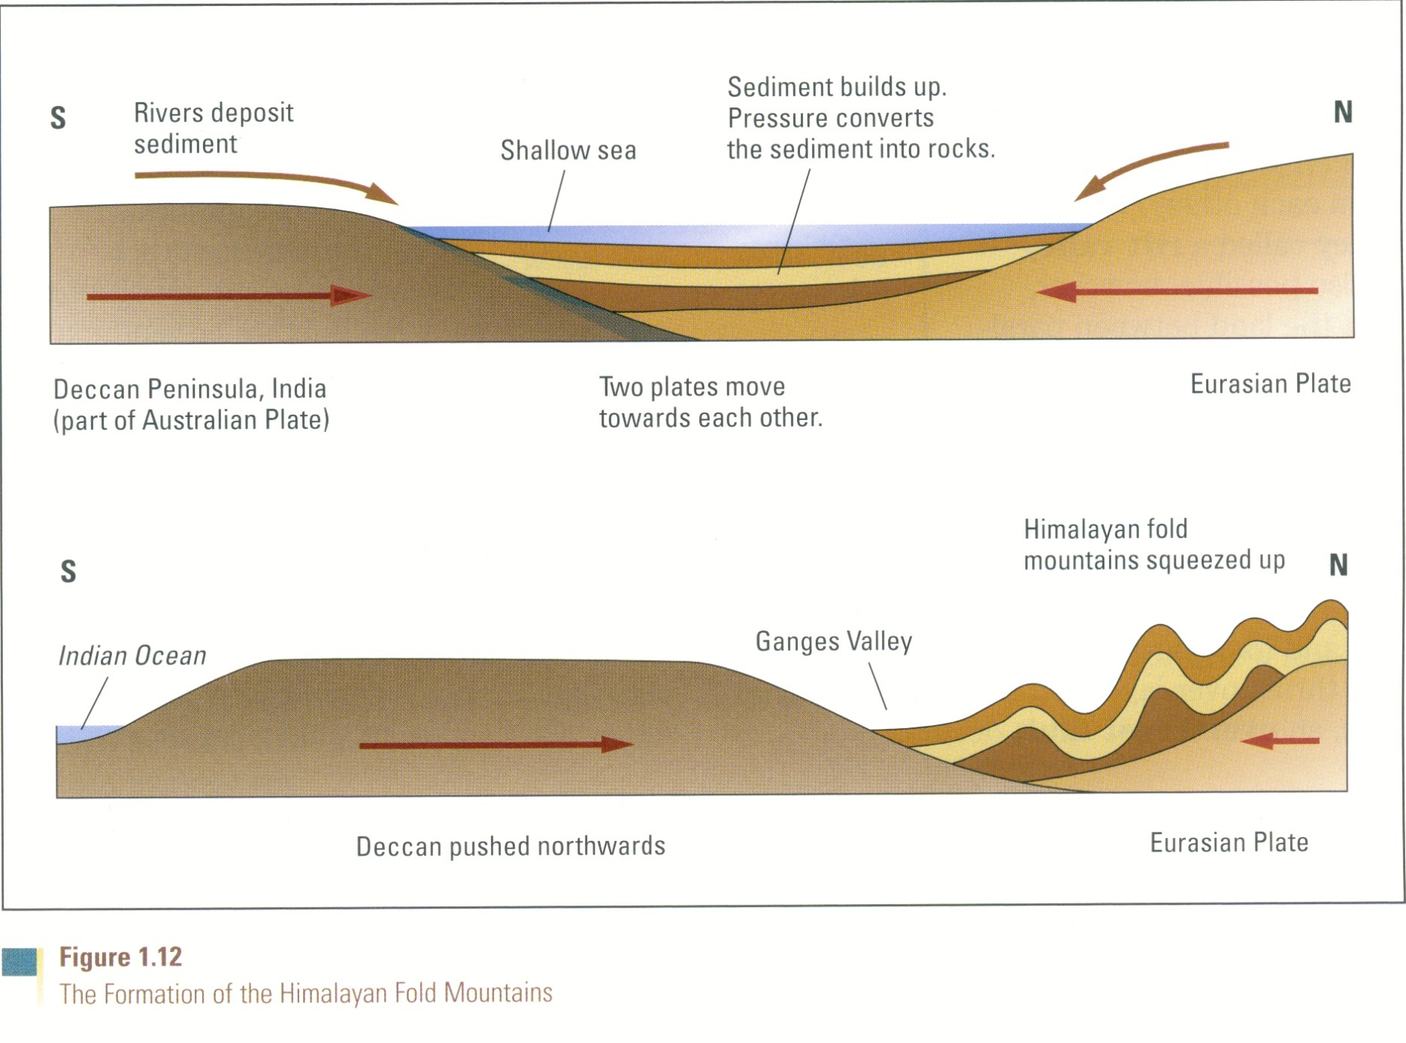
Diagram of fold mountain being formed

Slide 6
anticline and syncline
Simple folding forms are upwardly or downwardly pushed layers of the earth that resemble waves.
The Peak of a wave –like form is called the Anticline
The Trough of a wave-like structure is called the Syncline

Slide 7
How tensional forces create a normal fault
When plates are pressed against each other, intense pressure or the brittleness of the rocks involved may cause the rocks to fracture or break apart. This is called Faulting.
If a plate on one side of a fault drops down lower than the plate on the other side, the result is a normal fault

Slide 8
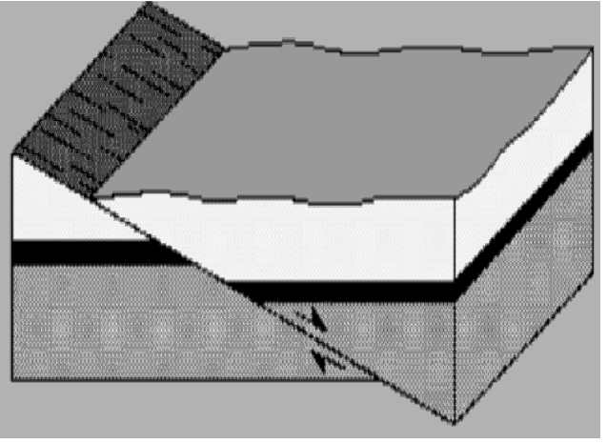
Diagram of a normal fault

Slide 9
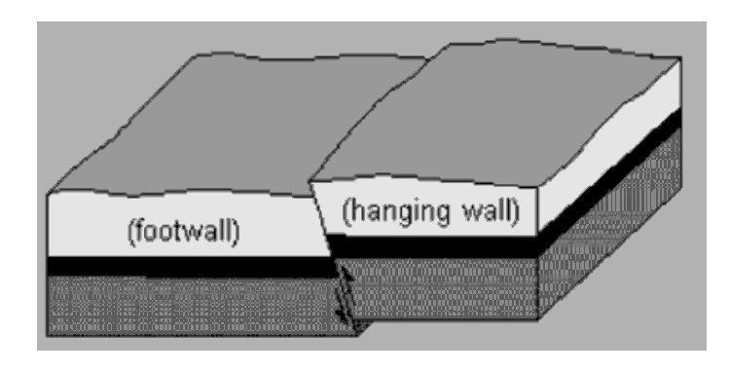
reverse fault
If simple rock layers push against each other instead of pulling away, one block may be pushed up over the other, resulting in a Reverse Fault

Slide 10
Overthrust Fault
If a plate that suffers a Reverse Fault has already undergone folding, and its folded layers are then pushed up and thrust over layers on the fault’s other side, an overthrust fault occurs.

