Slide 1
World Geography 3202
Unit One
Land And Water Forms

Slide 2
Introduction
Unit 1 introduces You to the concept that the earth’s surface is shaped by building-up and wearing away forces.
The unit will help You to examine the constituent parts of the physical environment, forces that created them, patterns in their distribution, and how they influence selected human activities.

Slide 3
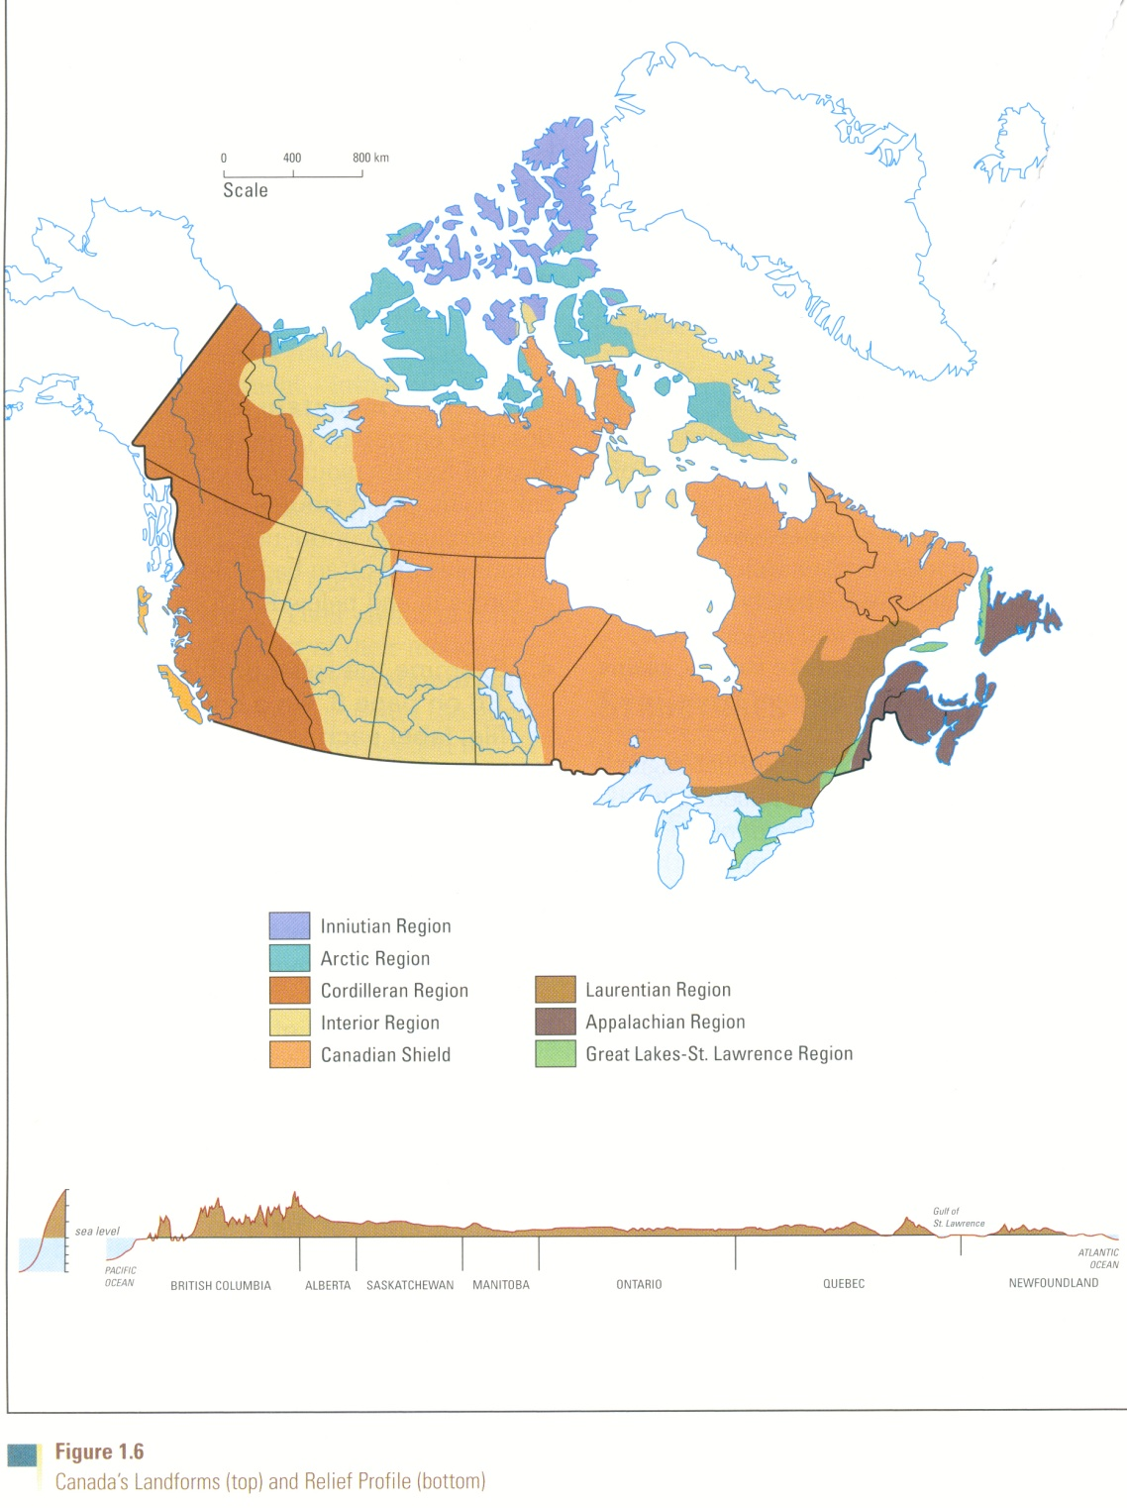
Patterns in the location of landforms on the earth’s surface
Q#1 What category of landforms would be reflected in this type of diagram
Q#2 What patterns can be seen from the diagram of landforms illustrated here?

Slide 4
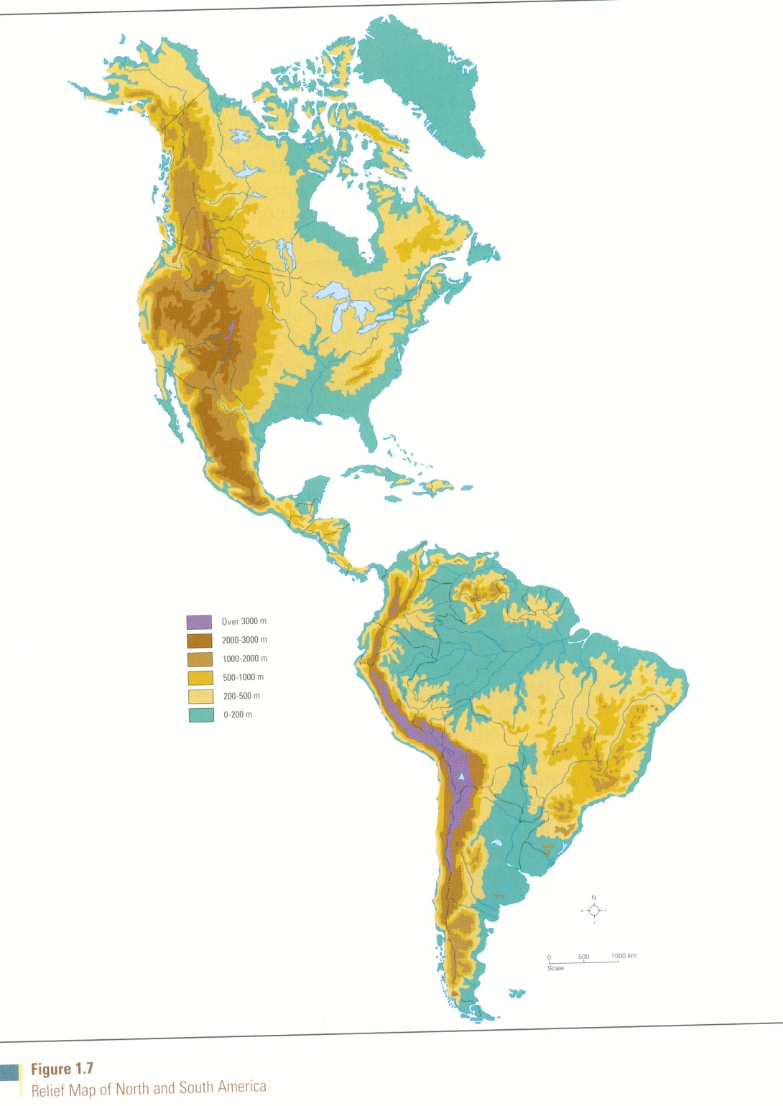
Relief map of North America
Q#1 How would you describe the distribution of landforms illustrated in this map?
Q#2 What type of landforms can you identify on this map?
Q#3 Where in the Americas are you most likely to encounter Mountains
Large Lakes
Plains and Plateaus
Large Rivers
River Deltas

Slide 5
Questions for Review
Define the term topography.
Differentiate among the terms hill and mountain, and plain and plateau.
Identify: seismology; minerals; rocks; compounds; elements; Igneous rocks; Sedimentary rocks; metamorphic rocks; Valleys;
Describe the distribution of these landforms over the earth’s surface

Slide 6
How did this distribution come about?
The earth’s landforms are never static: That is to say, they are constantly in a state of change due to forces at work that both wear down the land, as well as build up and shape the land.
First, we are going to look at forces that build up and shape landforms,….

Slide 7
Forces that shape the earth’s land formations
The face of the earth is shaped by tectonic activity.
Tectonic activity can be described as the movement of the earth’s crust, or “plates” as a result of the pull of gravity; convection currents, or the circulating movement of fluid rocky material in the mantle; and thermal plumes, or vertical columns of molten rocky material in the mantle.

Slide 8
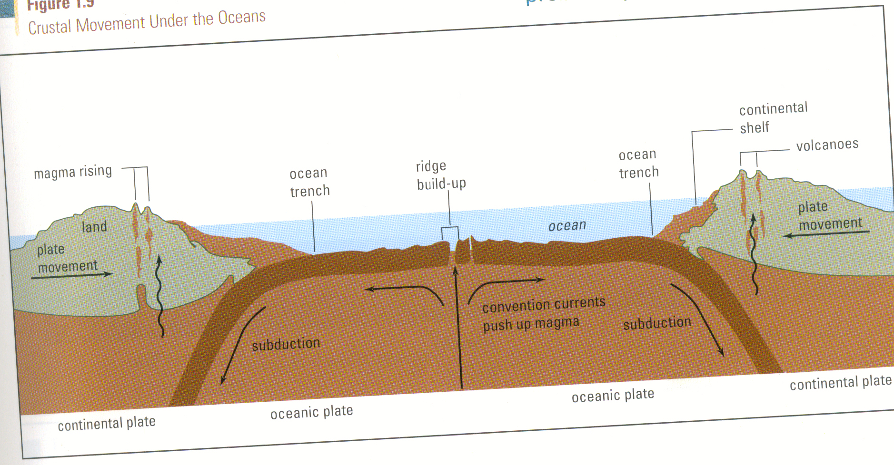
Crustal Movement Under the ocean

Slide 9
How Plate Tectonics Explains the shaping of landforms
The theory of plate tectonics was formulated during the early 1960s, and it revolutionized the field of geology.
Scientists have successfully used it to explain many geological events, such as earthquakes and volcanic eruptions as well as mountain building and the formation of the oceans and continents.

Slide 10
What are Tectonic Plates?
Tectonic plates are made of either oceanic or continental crust and the very top part of the mantle, a layer of rock inside the earth.
This crust and upper mantle form what is called the lithosphere.
Under the lithosphere lies a fluid rock layer called the asthenosphere.
The rocks in the asthenosphere move in a fluid manner because of the high temperatures and pressures found there.
Tectonic plates are able to float upon the fluid asthenosphere because they are made of rigid lithosphere.

