Slide 1
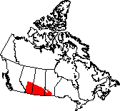
The Prairie Ecozone

Slide 2
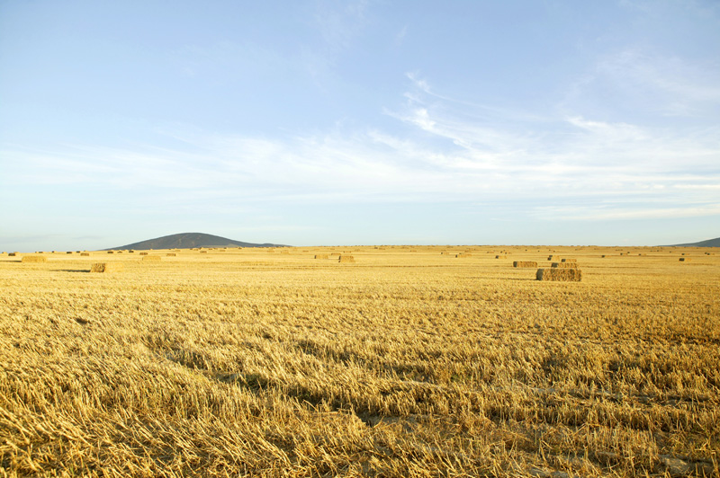
Glossary Words!
Potholes
Slough
Drought
Badlands
Grasslands
Shelterbelt
Windbreak
Chinook

Slide 3
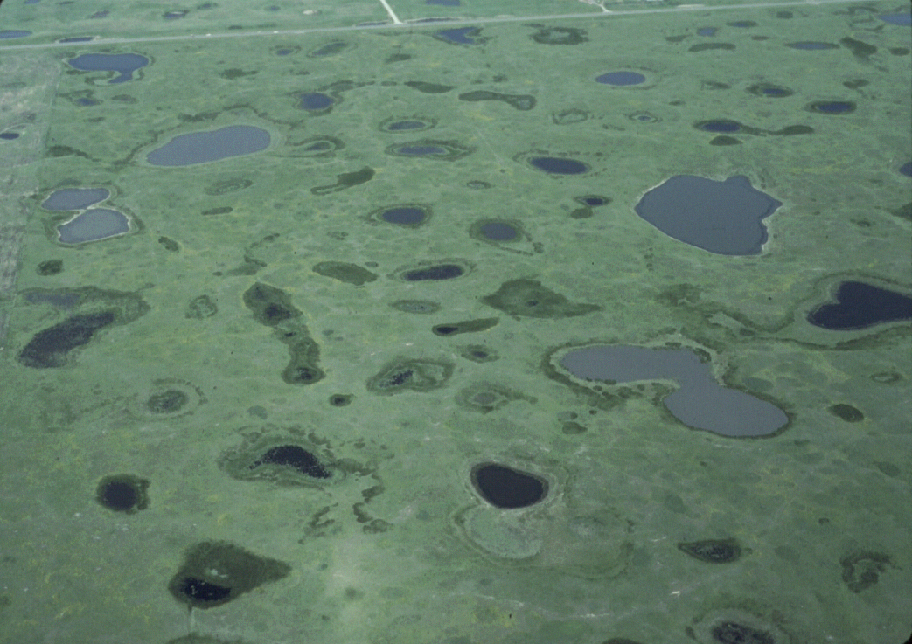
Landscape
The Prairie land is very distinct
From above, the land appears flat. However, a closer view reveals depressions in the soil (potholes) that are left behind by glaciers.
Many depressions have become wetlands which support a variety of plant life and wildlife

Slide 4
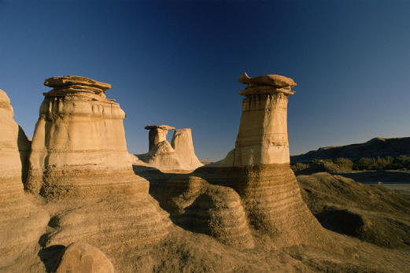
Landscape
Other aspects of the Prairie landscape include:
River valleys
Hills and eroded badlands (an unusual landscape created by the erosion of soft sedimentary rock.)
Gently rolling grasslands
A mixture of different grasslands
Impressions of the Prairie Ecozone (p128)

Slide 5
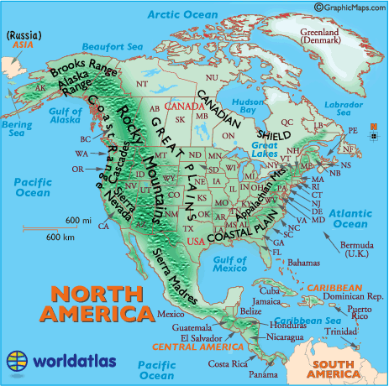
Landscape
The Prairies are a continental climate. This is because:
They are located in the centre of the continent.
The Rocky Mountains to the west act as barriers against rain bearing winds.
Dry arctic masses move in from the north, making the winters long and cold.
They are far from the moderating effects of bodies of water.

Slide 6
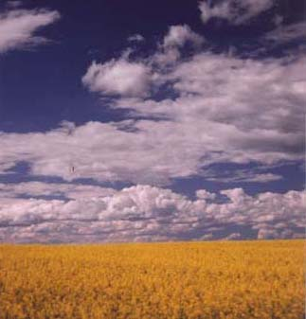
Vegetation
Wet and rich nutrient filled areas give way to fertile soil
Tall grasses grow in wet areas, while shorter grasses grow in drier areas.
Drought resistant plants such as sagebrush and short grasses grown in drier areas.
90% of the Prairie landscape is used for agriculture.

Slide 7
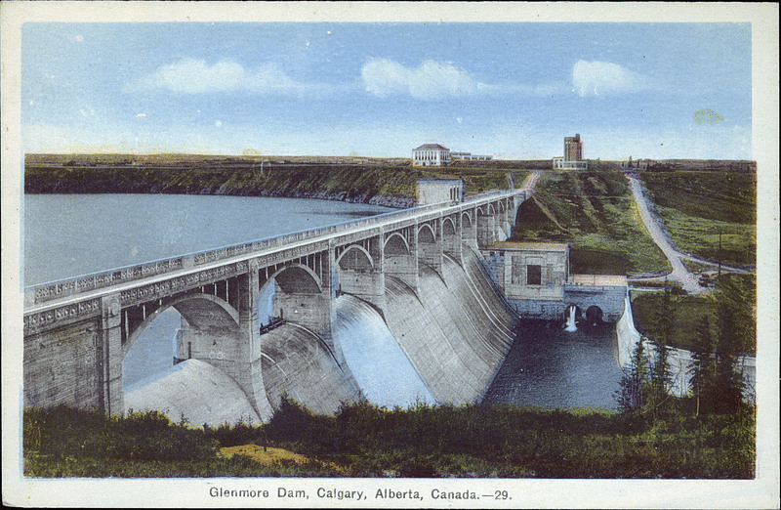
Disappearing Grasslands
Less that half of the prairie's original wetlands, potholes and sloughs remain.
Many have been drained and cleared for farming and urban development.
This development has led to the disappearance of many of the wildlife in the area.
Human activities, such a building dams for irrigation, hydroelectricity and flood control, have forever changed the river systems of the prairies.

Slide 8
Grasslands (p.134)

Slide 9
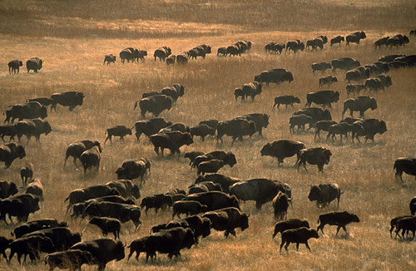
Wildlife
Plain bison were once plentiful in the prairie ecozone.
Overhunting in the late 1800’s drastically decreased their numbers, virtually wiping them out
Today, plain bison are protected in national parks, where their numbers are growing

Slide 10
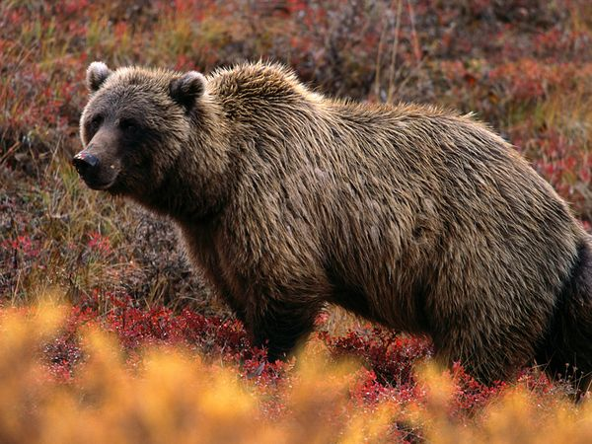
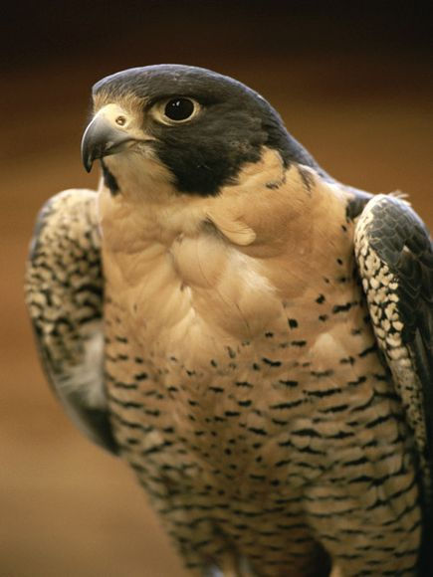
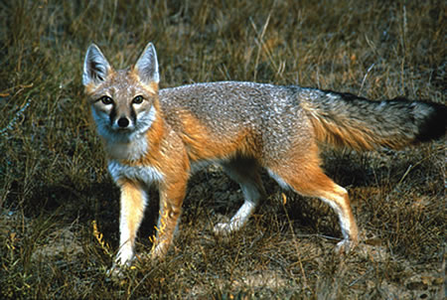
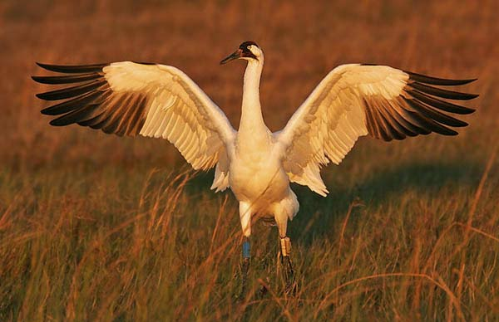
Wildlife
An abnormally large number of animals have disappeared from this ecozone. Many are extinct, extirpated, endangered or threatened because of habitat loss.
This includes:
The grizzly bear (disappeared from area)
The swift fox (disappeared from area)
The peregrine falcon (endangered in the area)
Whooping crane (endangered in the area)

Slide 11
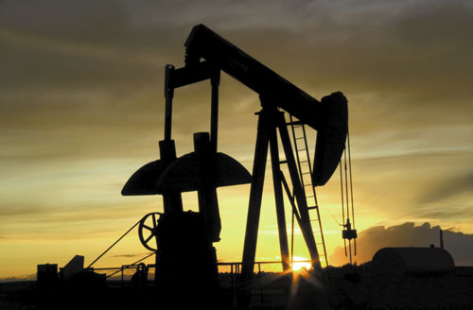
Humans
The gently rolling land of the prairies is suitable for food production
The grasslands have fertile soil and a long enough growing season for a variety of crops.
The rivers can be dammed for irrigation and hydroelectricity
Oil and gas deposits in sedimentary rock are excellent for the mining industries.

Slide 12
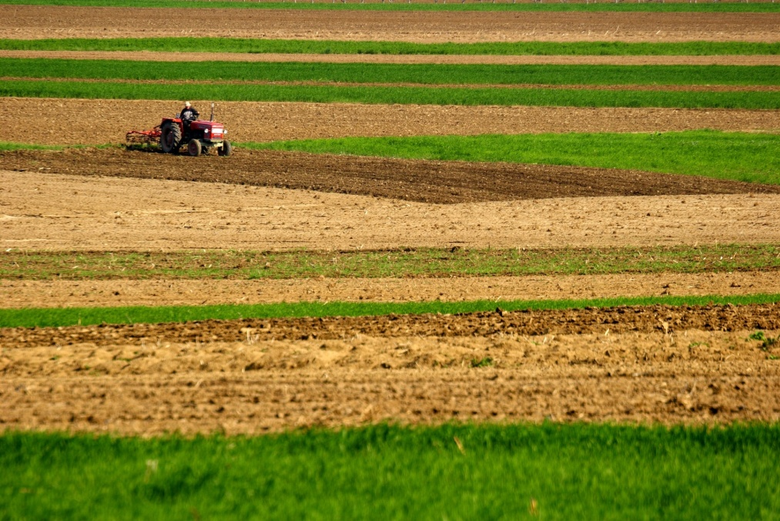
Threats
Modern farmers have almost wiped out keystone species in the area (swift fox, prairie dogs) much like early settlers almost wiped out the bison population.
Extensive agriculture uses land and destroys wildlife habitats
Farming overworks the soil and reduces nutrients
Wastes from farms and urban areas pollutes the waters.

Slide 13
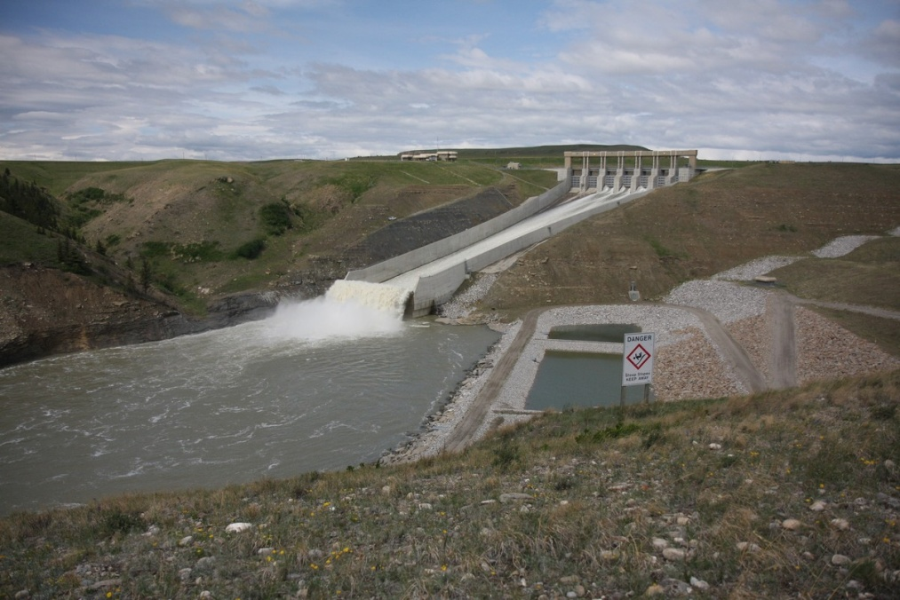
Threats
Oil and gas development creates pollution and contributes to greenhouse gas emissions, which eventually changes the climate.
Dams and reservoirs built for power, flood control and irrigation alter rivers and wildlife habitats.
Conservation efforts and government regulations aim to restore some wildlife and grasslands.

