Slide 1
Southern Arctic

Slide 2
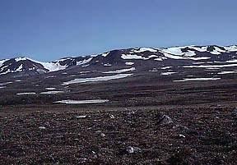
Landscape
a lot of this ecozone is made up of piles of sand and gravel left over by glaciers that melted 8500 years ago.
Now there are lots of moraines (mounds of dirt) and eskers (long ridges of sand).
The glaciers tore up the land, leaving many holes that were filled with the melting ice. As a result, there are lots of lakes and ponds found here.

Slide 3
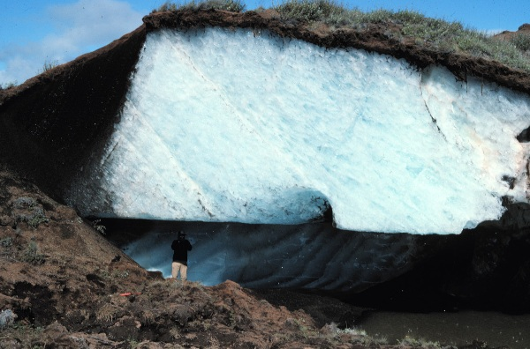
Landscape
There’s a lot of permafrost (permanently frozen ground) in this ecozone, often just a few centimetres below the surface. Although there is little precipitation, moisture gets caught just under the surface.

Slide 4
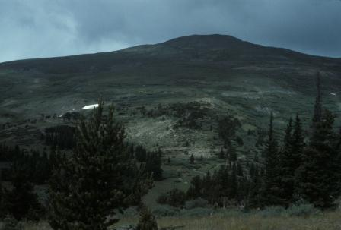
Vegetation
The treeline is found along the southern part of the Southern Arctic. The trees get much smaller and eventually disappear above this line.
As a result, there aren’t many large plants in the area. Mostly shrubs and, in the summer, berries.
The cold air and dry winds make it difficult for taller trees to grow.

Slide 5
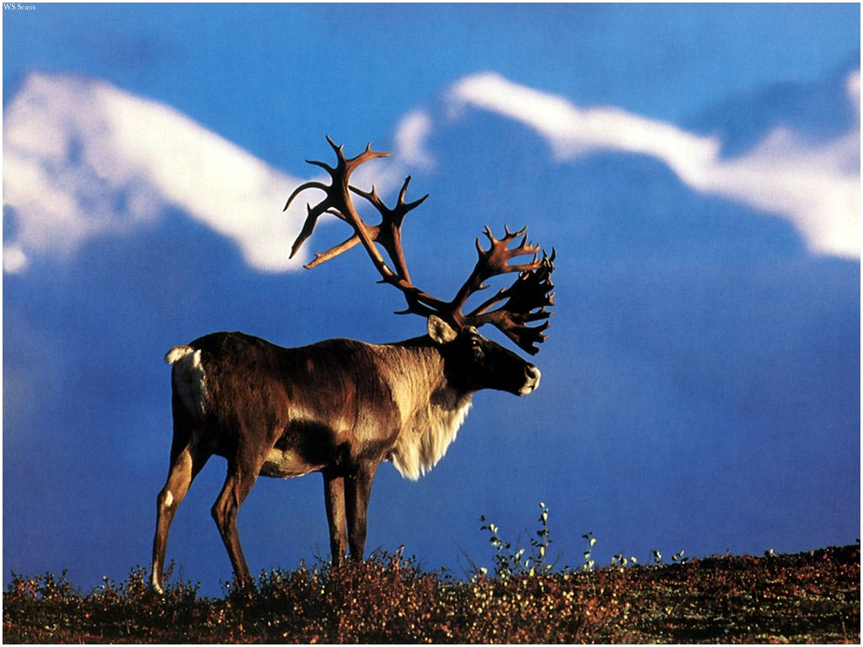
Wildlife
Due to the cold most of the year, the number of species found in the Southern Arctic drops the further north you go.
Caribou, foxes, bears, moose, and hawks are some of the animals and birds you can expect to find. Close to a million caribou migrate south each year.

Slide 6
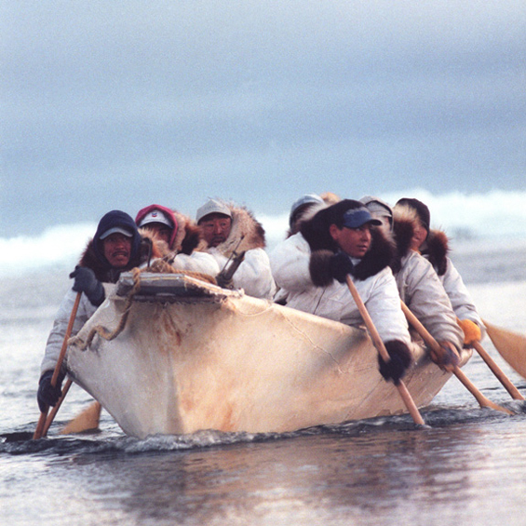
People
The Inuit make up 80% of the population of the Southern Arctic.
There are less than
10 000 people in this ecozone, spread out over 17 communities.

Slide 7
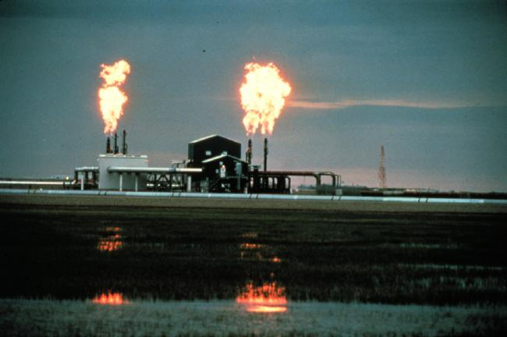
Threats
The area is very rich in minerals and oil and gas. This means a lot of the land is being destroyed to exploit these resources.
Global warming is also having negative effects on the area, causing much warmer than normal temperatures. Wildlife and vegetation in the area, not being used to the warmer weather, are migrating or dying.

