Slide 1
Atlantic Marine Ecozone

Slide 2
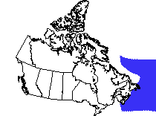
Landscape
This ecozone only touches land at the southern coast of New Brunswick and Nova Scotia and the eastern coast of Nova Scotia and Newfoundland.

Slide 3
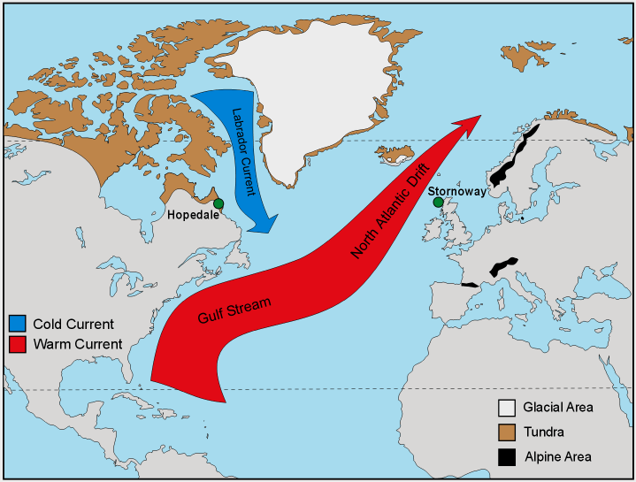
Landscape
Winds from land to the west meets the warm Gulf stream, making the ecozone more temperate than it would otherwise be.
Dense fog forms when the warm gulf stream meet the cold Labrador current.

Slide 4
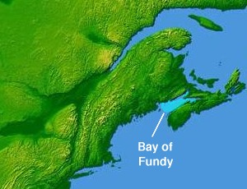
Landscape
The Bay of Fundy features the largest tide in the world.
The difference between high and low tide can go as far as 15 metres in the difference.

Slide 5
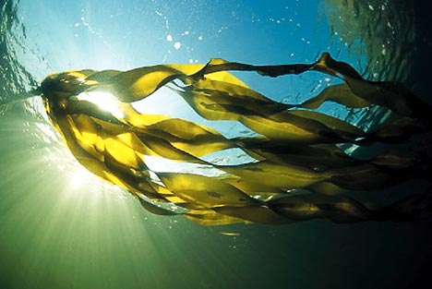
Vegetation
Phytoplankton : microscopic plant like organisms. They are the base of the marine food web.
Seaweed and kelp are also found throughout the region

Slide 6
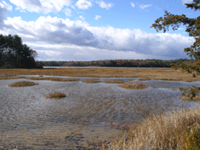
Vegetation
Tidal Marshes
Extensive salt marshes occur particularly in New Brunswick, Nova Scotia, and Prince Edward Island but less frequently in Newfoundland. Examples of vegetation in this area are:
Saltmarsh Cord grass
Wild Barley
Sea lavender

Slide 7
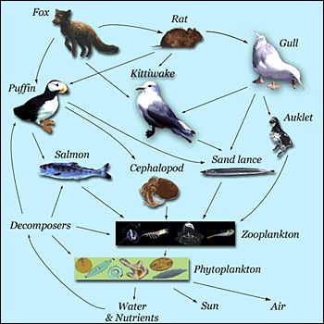
Wildlife
The Grand Banks are among the most biologically productive marine areas in the world
Labrador Current + Gulf Stream
Shallows of the continental shelf prepare ideal feeding grounds and spawning conditions.

Slide 8
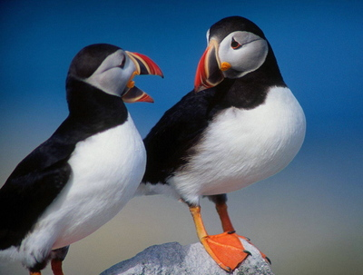
Wildlife
Animals and fish such as the northern cod, herring, grey seals, harbour porpoises, puffins and gulls live in this ecozone.
There are also a number of bottom dwellers in the Atlantic:
Barnacles, sea stars, lobsters

Slide 9
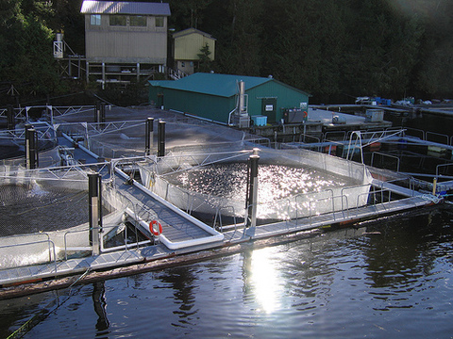
People
The people of Atlantic Marine significantly depend on the ecozone for their livelihood.
Fishing
Lobster, shrimp, crab
Aquaculture
Experiments in scallop, salmon and cod farming
Mussel farming
Offshore Oil and Gas
Hibernia, Terra Nova oil and gas fields, reserves in Nova Scotia

Slide 10
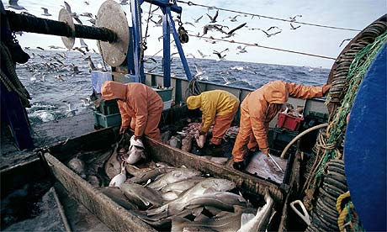
Threats
Overfishing
Canadian and foreign fishing have driven down commercial cod populations to a serious level.

