Slide 1
Turbot War
1977, Canada extends its fishing limits from 22 km to 370 km.
Spanish have been fishing on the Grand Banks for hundreds of years.
Most European fishing banks were overfished and destroyed.
Series of incidents between January and April 1995 lead to Canada seizing a Spanish trawler outside of the 370 km zone.

Slide 2
The Pacific Fishery
Salmon is the main catch
5 types of salmon: chum, pink, spring, coho, and sockeye
Fraser River has Canada’s largest salmon resource, 25% of the BC Salmon catch has come from the Fraser.
The life cycle of the salmon begins and ends in freshwater rivers of the west coast. Mid life is spent in salt water in North Pacific. After 2-3 years they return to the freshwater, during this time the harvest begins.

Slide 3
The Pacific Fishery
The Life Cycle of Salmon, courtesy of the Discovery Channel
http://www.youtube.com/watch?v=5DqjsWsY8-g&safety_mode=true&persist_safety_mode=1

Slide 4
Salmon Habitat Under Attack
Logging:
Logs hauled up the Fraser river, damage habitats.
When you clear cut forests on mountains, soil erosion occurs. The mud and silt gets into the river and covers the spawning beds.

Slide 5
Salmon Habitat Under Attack
Pollution:
herbicides and pesticides from agriculture pollute the river.
Development:
2 Million people and industries located around the estuary
Wharfs and marinas have been created. Dams have been built. Water flow is less and fewer nutrients are in the river.

Slide 6
Decline in the Salmon Fishery
1996 Salmon levels in the Pacific Ocean were at an all time low.
New technology led to commercial fleets catching in hours what they used to catch in days.

Slide 7
Decline in the Salmon Fishery
Drift Nets – used by Japan, Korea, Taiwan, fleets. The nets are 1km in length – main catch is Tuna other large fish.
Since 1995 the United States and Canada have had no talks about what to do in salmon fishery.

Slide 8
Decline in the Salmon Fishery
An increase in temperature has resulted in an increase in mackerel which feed on young salmon.
Commercial fleets harvest 90% of the salmon each year. The other 10% is made up from sport fishers and natives.
1996 Government decreased commercial fleet by 50%. Over 1500 boats will not be fishing.

Slide 9
Freshwater Fishery
Biggest is centered in the Great Lakes.
Others include Lake Winnipeg, Great Slave Lake (Northwest Territories) and hundreds of smaller lakes.
180 different species of fish. Whitefish, perch, pickerel, trout and bass are among the major ones.

Slide 10
Aquaculture
Raising of marine life in controlled environment such as fish farming. The breeds are raised in tanks, ponds and reservoirs.
Potential concerns about disease.
Predators
Salmon, trout, mussels, oysters- leading seafood raised in Canada trough fish farming.
In 2005, Canada produced 154 million tonnes of cultured fish and seafood valued at $715 million.

Slide 11
Aquaculture
Marine Harvest Canada
http://www.youtube.com/watch?v=SB3MIlWGt54&safety_mode=true&persist_safety_mode=1

Slide 12
The Seal Hunt in Canada
From the Department of Fisheries and Oceans
In 2006 the value of the harvest to the economy was in excess of C$55m (approx. €34m) in Newfoundland and Labrador and C$1m (approx. €0.62m) in Nunavut.
Sealing can provide as much as 35% of a sealer's annual income, which is approximately C$25,000/€15,750.

Slide 13
Death on the Ice
http://books.google.ca/books?id=sOAJmRd_4p4C&printsec=frontcover&dq=Death+on+the+Ice&hl=en&ei=UQxkTfXgDYuugQfivpS3Ag&sa=X&oi=book_result&ct=result&resnum=1&ved=0CC0Q6AEwAA#v=onepage&q&f=false

Slide 14
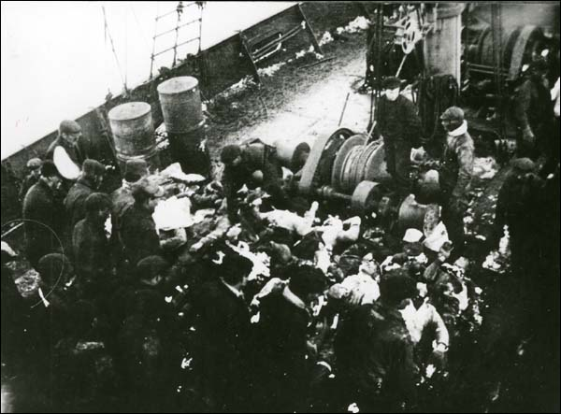
Seal Disaster
Dead sealers, 4 April 1914 The sealing vessel SS Bellaventure arrived at the port of St. John’s on 4 April 1914 with 69 dead sealers stacked on its deck. The men, all from the SS Newfoundland, died after being stranded on the North Atlantic ice floes in blizzard conditions for 53 hours. John’s, NL.

Slide 15
Newfoundland Sealing Disaster 1914
http://www.youtube.com/watch?v=mcQDFgghAQY&safety_mode=true&persist_safety_mode=1
http://www.youtube.com/watch?v=-nvdSLr8vNc&feature=related&safety_mode=true&persist_safety_mode=1

Slide 16
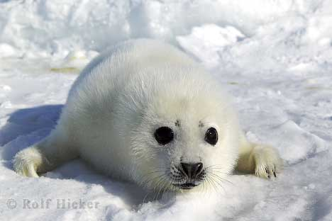
Baby Seal

Slide 17
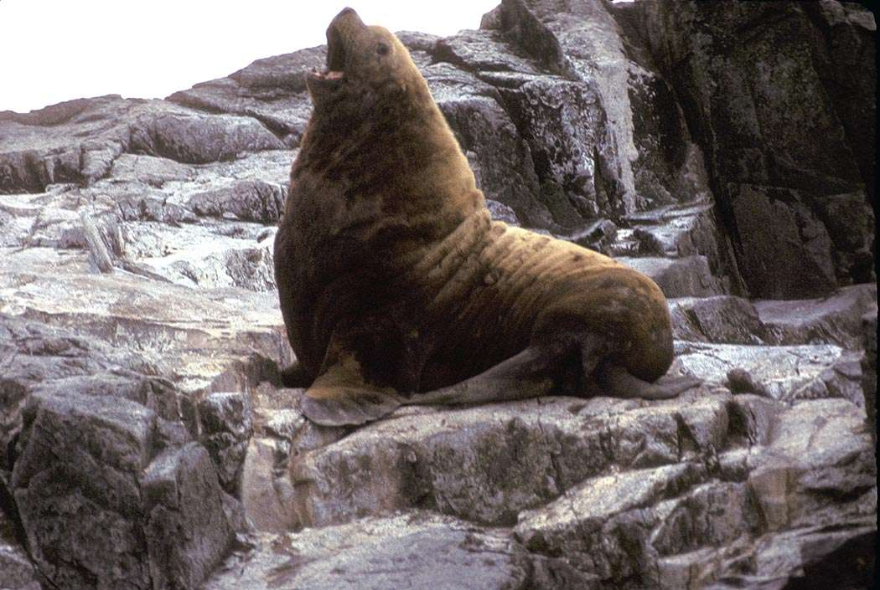
But then they grow up

Slide 18
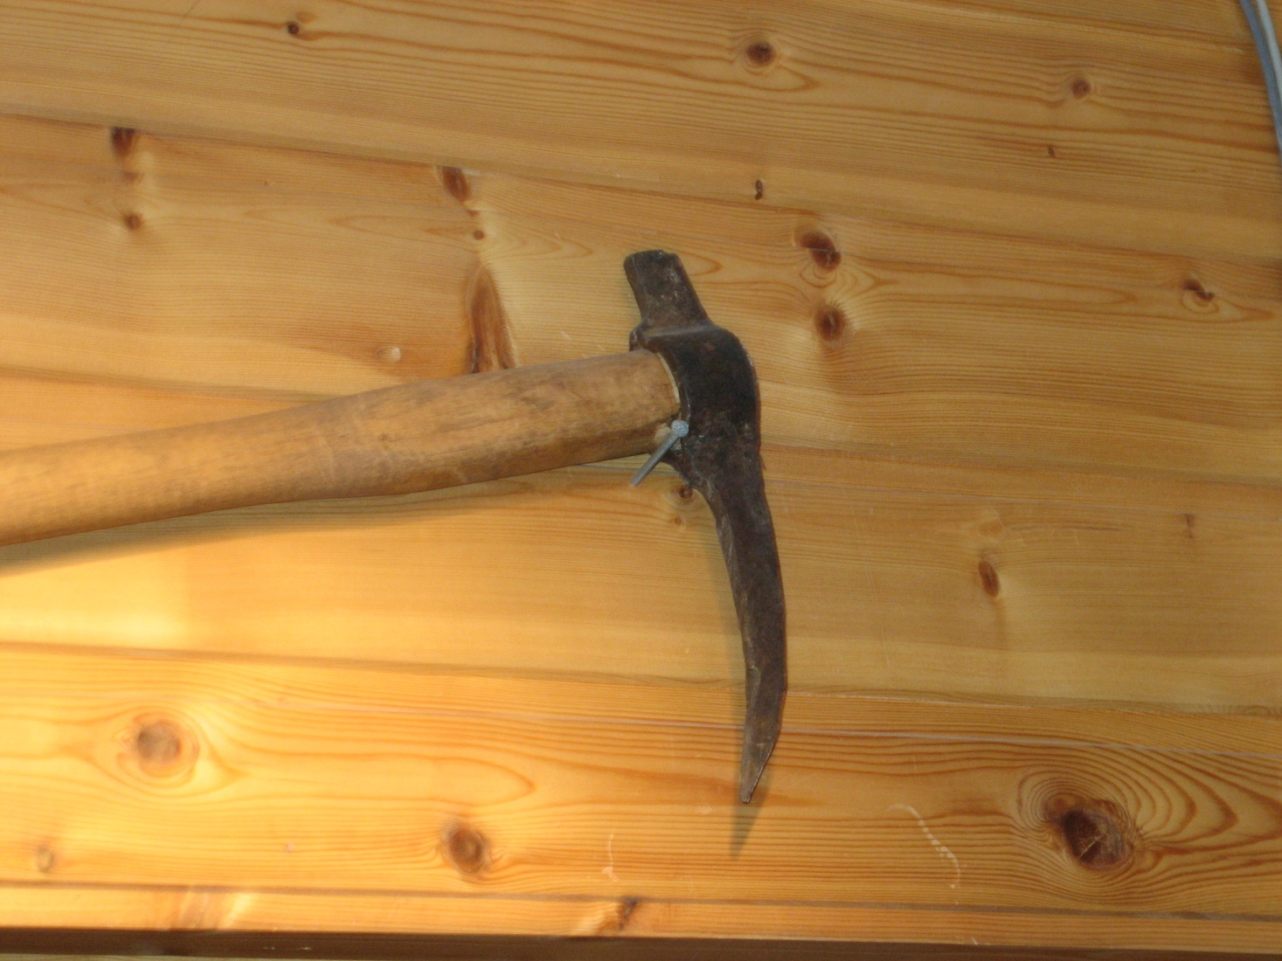
Hakapik

Slide 19
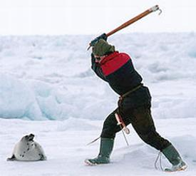
Hakapik

Slide 20
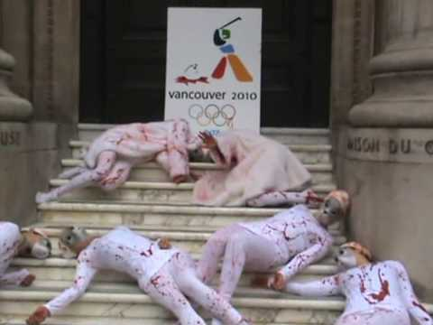
Protests Have Occurred

Slide 21
Rex Murphy and Sealing
http://www.cbc.ca/video/#/News/TV_Shows/The_National/Rex_Murphy/1267807042/ID=1305673008
http://www.cbc.ca/video/#/News/TV_Shows/The_National/Rex_Murphy/1267807042/ID=1305673381

Slide 22
Seal Hunt Controversy
Animal rights groups claim that the hunt is inhumane.
The methods used by the hunters have been approved by a veterinarian group.
The goal is a quick death with little pain.
They have claimed that it is poorly regulated.
Department of Fisheries and Oceans counters that quotas are enforced.

Slide 23
Seal Hunt Controversy
They have claimed that it is unsustainable.
Department of Fisheries and Oceans counters that it is sustainable. The harp seal population is at a thirty year high; they are not endangered.

Slide 24
Paul McCartney and Danny Williams on CNN
http://www.youtube.com/watch?v=ft1wSUxZf5M&safety_mode=true&persist_safety_mode=1
http://www.youtube.com/watch?v=pmL-oSm5G3c&safety_mode=true&persist_safety_mode=1
http://www.youtube.com/watch?v=7qrtdcz6ugU&safety_mode=true&persist_safety_mode=1

Slide 25
The Test
15 multiple choice
Three constructed response
Case study
Aquaculture handout: know the four types of aquaculture
Pay particular attention to: bold letters, marine food chain, life cycle of Salmon, threats to Salmon habitat, Cod Moratorium (three ways it impacted people), vertically integrated company (with example!) and the difference between inshore and offshore fishery. And the main lakes of the freshwater fishery.

