Slide 1
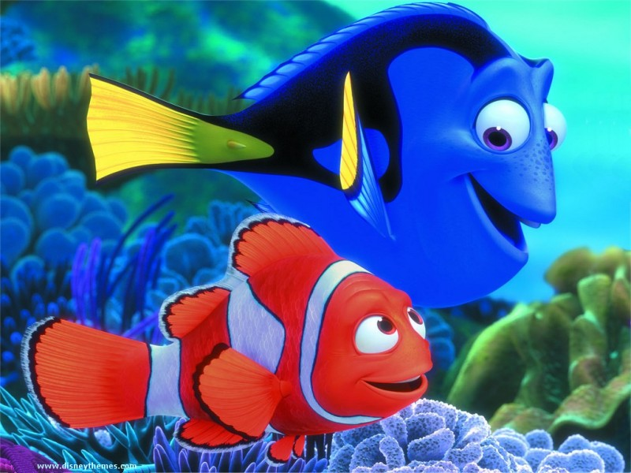
Chapter 8-Fishery
Canadian Geography

Slide 2
Memory Waltz by Rawlins Cross
http://www.youtube.com/watch?v=BsEN6ZawgnU&safety_mode=true&persist_safety_mode=1

Slide 3
Canadian Fishery
Three main fisheries:
Atlantic
Pacific
Freshwater
Each fishery faces the same two problems:
Overfishing
Pollution

Slide 4
Canadian Fishery
Figures from the Department of Agriculture
The industry is worth more than $5 billion a year.
Provides more than 130,000 jobs to Canadians.
Economic mainstay of approximately 1,500 communities in rural and coastal Canada.

Slide 5
Atlantic Fishery
John Cabot reached the shores of Newfoundland in 1497.
http://www.youtube.com/watch?v=261-NYB7Sko&safety_mode=true&persist_safety_mode=1

Slide 6
Atlantic Fishery
Inshore Fishery:
Independent fishers use small boats to fish in the waters close to the coastline. They come home every night.
High overhead costs.
Pay is irregular but it is a way of life.

Slide 7
Atlantic Fishery
Inshore Fishery continued:
Catch includes: lobster, shrimp, oysters, clams, herring, mackerel, haddock, pollock, redfish, hake and halibut.
Cost of a new vessel: $200,000.
Only 5 to 20 m in length.

Slide 8
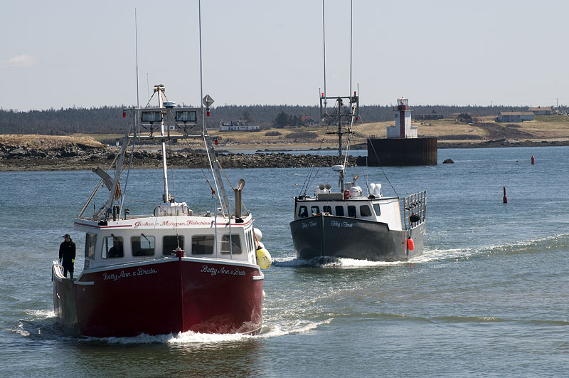
Inshore fishing boats

Slide 9
Atlantic Fishery
Offshore Fishery:
Use large company owned vessels like trawlers to fish in waters far from shore.
Can withstand bad weather conditions better than inshore fishers. Can operate all year long.
Only 15% fishers work in the offshore but it takes 90% of the catch.

Slide 10
Atlantic Fishery
Offshore Fishery continued:
Huge nets that drag along ocean floor.
The boats have their own processing equipment on board.
20 to 5o m in length. Can cost as much as 5 million to build.
Can make 24,000 in one year as opposed to 6,000 in the inshore fishery (1990 figures).

